Slide 1


PMATE BackOffice
Elaboration Phase
Projeto em Informática – 19 de Abril 2021

Slide 2
Index
Context and State of The Art (SOA)
Requirements gathering
Functional requirements
Non-functional requirements
System Architecture
Actors
Use cases
Mock-Up

Slide 3
Context What previous works exist in this context?
Pmate BackOffice is a management platform for admins
An equivalent currently operational plataform already exists for this purpose
Existing platform is non-intuitive, the technology outdated (has barely received any changes in 20 years) and contains many unused and not implemented features.
New Platform goals:
Cleaner and more appealing interface
Use of a more up-to-date framework - .Net Core MVC
Improvements on the database model (Migration to .Net Identity tables)

Slide 4
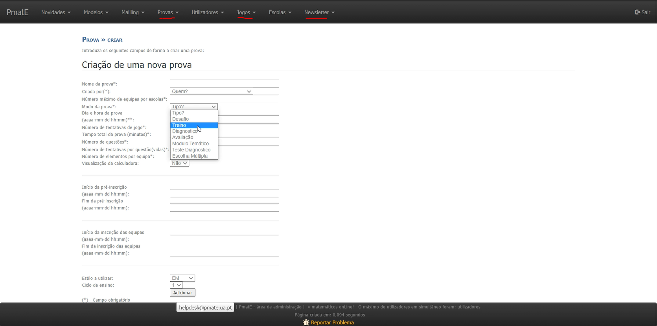
Old Platform

Slide 5
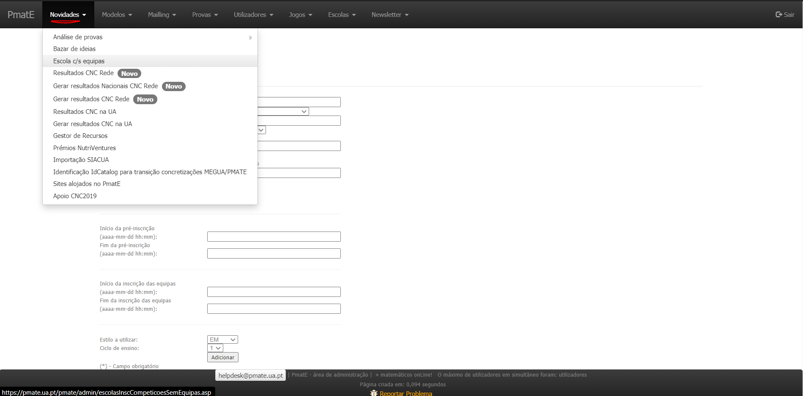
Old Platform

Slide 6
State of the Art (SOA)
New competitions coming up implies the necessity to create new tests
When new schools want to be part of Pmate, admins handle their registry
At any time, new training tests may be created for students to practice on the main Pmate website
During competitions, any problems/bugs that participants stumble upon are handled by admins

Slide 7

Requirements

Slide 8
Requirements gathering
This platform is used only by a few group of people doing administrative work
Direct communication (via online meetings) with:
One of the people responsible for Pmate’s Systems (Advisor of the project)
A user of the current Backoffice

Slide 9


Functional Requirements
Database
Currently containing duplicated information due to the strategy used in the categorization of users (main table + individual table for each user-type)
Must be replaced by a strategy that depends on roles.
Legal
The user must have the possibility of deleting his account if he wishes to do so.

Slide 10

Functional Requirements
User Requirements
List past competitions
List the tests of a competition
Options for various kinds of statistical info. (registered teams per school, total score per school, etc.)
Search for and recover the state of a test in a competition
Option to generate an HTML with the results of a competition.

Slide 11
Functional Requirements
User Requirements (cont.)
Register a School
List schools
Map view of the schools involved in Pmate
Pre-inscription of schools in contests
Associate a teacher to a school

Slide 12
Functional Requirements
User Requirements (cont.)
Create a new test or training game.
Copy ‘question models’ from an older to a new test.
List students by school/teacher
Communication via email for a user or a target group of users (teachers, students, etc.)

Slide 13
Functional Requirements
User Requirements (cont.)
Possible Extra: New Tab with a group chat for the administrators’ easier communication? (Como o nosso trabalho não implica nenhuma tecnologia mt avançada, neste chat de grupo podemos explorar um pouco mais )
Possible Extra: New Tab to manage the roles of the Users : Search Users, Select User, Add/Remove roles

Slide 14


Non-Functional Requirements
Implementation
The System should be developed in C# and HTML/CSS/JS using .NET Core MVC Framework.
The System must be integrated with an existing SQL database.
Efficiency
Loading data from the database to the interface should be fast.
Updating the data from the database numerous tables should be fast.

Slide 15


Non-Functional Requirements
Portability
The System must be supported in various platforms.
It should allow authentication from external services (i.e., UA, Facebook, Google)
Security
Users’ passwords must be encrypted.
Two factor authentication should be possible.
The platform must only provide access to select users, with the admin role.

Slide 16

Non-Functional Requirements
Usability
The Navbar and Its menus must be simple and intuitive to use.
The presentation of results must be paginated to make their reading easy and organized
Legal
After deleting an account, although some of users’ data may be kept for history registries purposes, any personal information is hidden (overwritten by anonymous tags)

Slide 17
System Architecture

Slide 18
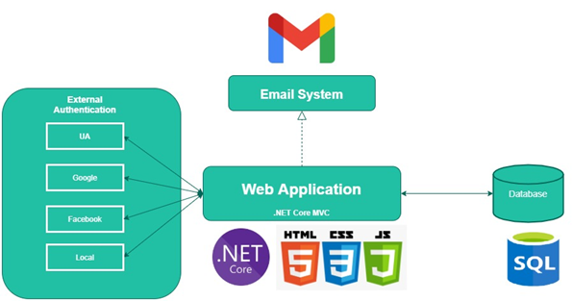
Deployment Diagram

Slide 19
Database Diagram

Slide 20
Database Dimensions
741,490 Users
562,871 Students
116,500 Teachers
23,902 Schools
220 Base Models
2,838,385 Games Generated
8,531,146 Individual Questions Generated

Slide 21

Personas

Slide 22
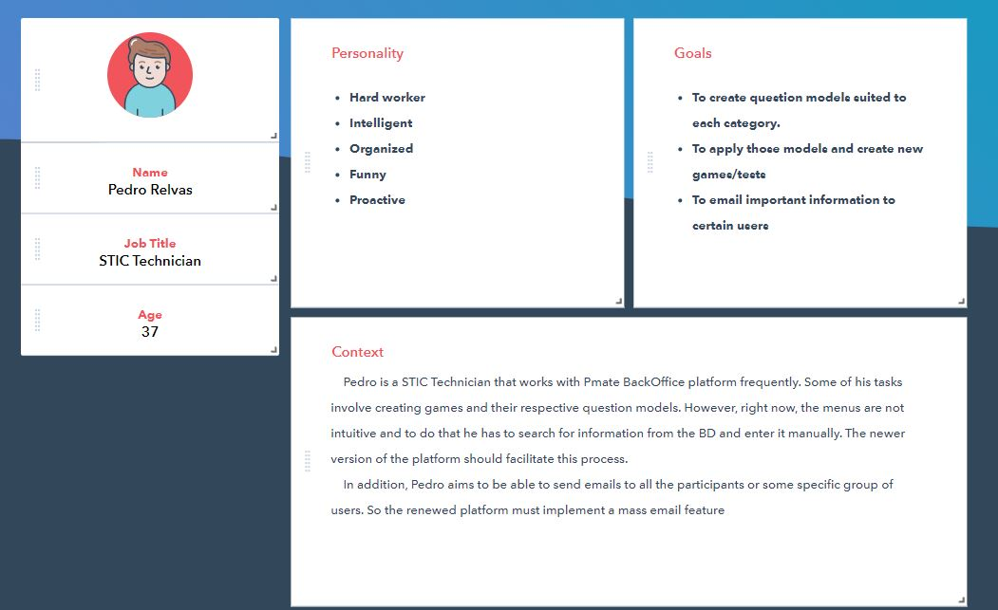
Persona 1

Slide 23
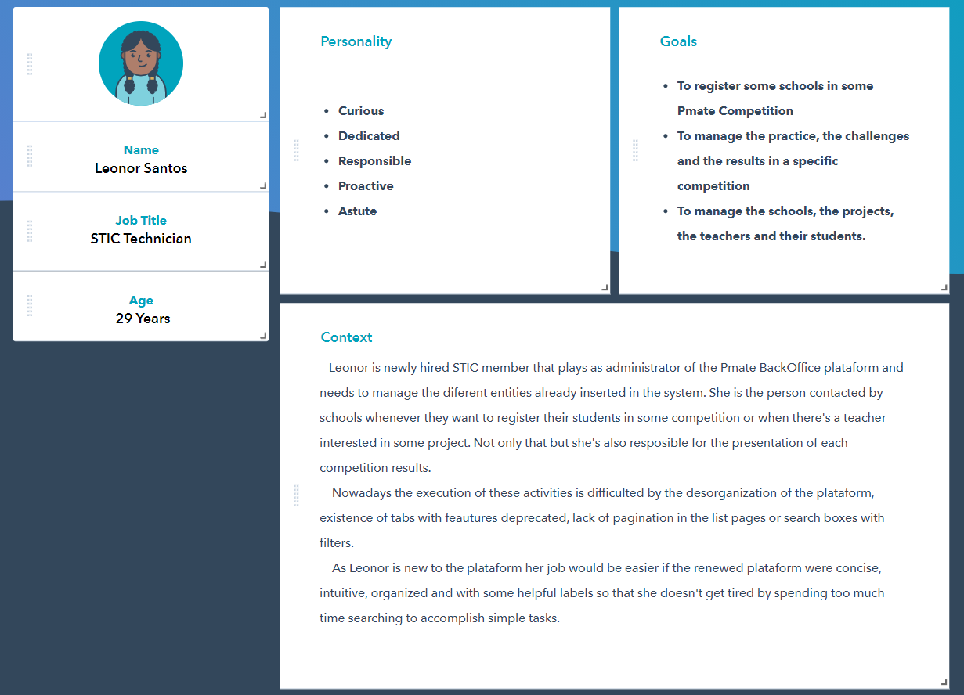
Persona 2

Slide 24
Use Cases

Slide 25
Use Case 1
Add/Remove user roles.
Step 1 - Go to the UTILIZADORES tab
Step 2 - Find the user whose role you want to change (by searching or filtering, or otherwise)
Step 3 - Click the Ver Perfil button on that user’s row.
Step 4 - You’ll then be able to change that user’s role.

Slide 26
Use Case 2
Send a mass Email to a group of people.
Step 1 - Go to the MAILING tab.
Step 2 - Choose a title and write an email message.
Step 3 - Select the sender.
Step 4 - Select who will receive it (other admins, teachers, students).
Step 5 - Press ENVIAR.

Slide 27
Use Case 3
Assign a School to a competition
Step 1 – Go to the COMPETIÇÕES tab.
Step 2 – Choose the INSCREVER ESCOLAS option.
Step 3 – Select the Competition.
Step 4 – Select the schools you want to sign up, by checkmarking them on the table.
Step 5 – Press the INSCREVER button

Slide 28
Use Case 4
Check the results of a competition.
Step 1 – Go to the COMPETIÇÕES tab.
Step 2 – Choose the LISTAR COMPETIÇÕES option.
Step 3 – Find the competition you want (by searching or otherwise)
Step 4 – Click the ‘VER MAIS’ button (+) on that competition’s row.
Step 5.1 – If the results aren’t generated yet, Click the ‘Gerar Resultados’ button to generate the results and view them.
Step 5.2 – If they are already generated, Click the ‘Ver Resultados’ button to view the results.

Slide 29
Use Case 5
Create a Training Game
Step 1 – Go to the TREINOS tab.
Step 2 – Choose the CRIAR option.
Step 3 – Fill out the form specifying the model for the questions, and other important information.
Step 4 – Submit.

Slide 30

Mock – Up

Slide 31

Questions?

Slide 32
PMATE - BackOffice
Elaboration Phase - End

